Slide 1

HEART DISEASE PREDICTION USING MACHINE LEARNING
Batch - A6
D NAGA PHANINDRA Y19AIT428
G RAMYA Y19AIT441
A LAKSHMI PRASANNA Y19AIT403
D BEAULA RANI Y19AIT425
Guided by
SHAIK MABASHA, M Tech
Asst Professor, IT Department

Slide 2
ABSTRACT
Heart-related diseases or cardiovascular diseases (CVDs) are the major reason for a huge number of deaths in the last few decades. Many researchers, in recent times, have been using several machine learning techniques to help the health care industry and professionals in the diagnosis of heart-related diseases. Some of the data mining and machine learning techniques are used to predict heart diseases, such as Random Forest, and Support Vector Machine (SVM), Artificial Neural Network (ANN),. The main objective of this research project is to predict a patient’s heart disease using machine learning algorithms.

Slide 3
INTRODUCTION
Heart is an important organ of the human body. It pumps blood to every part of our anatomy.
Changes in lifestyle, work-related stress, and bad food habits contribute to the increase in the rate of several heart-related diseases.
Heart diseases killed 1.7 million Indians in 2016, according to the 2016 Global Burden of Disease Report, released on September 15, 2017.
According to World Health Organization, heart-related diseases are responsible for taking 17.7 million lives every year, 31% of all global deaths.
Estimates made by the World Health Organization (WHO), suggest that India has lost up to $237 billion, from 2005- 2015, due to heart-related diseases.
Medical organizations, all around the world, collect data on various health-related issues, and the data is very massive and noisy, which is too hard for analyzing with human brains, and can be easily explored using various machine learning techniques.
ML offers an opportunity to improve accuracy by exploiting complex interactions between risk factors.
Thus, these algorithms have become very useful, in recent times, to predict the presence or absence of heart-related diseases accurately.

Slide 4
EXISTING SYSTEM
Chalabeyene and others recommended Prediction and Analysis of the occurrence of Heart Disease Using Data Mining Techniques.
Dataset is computed using WEKA software.
Senthilkumar Mohan et al, implemented hybrid machine learning for heart disease prediction.
Used dataset – Cleveland.
They have proposed their own Hybrid Random Forest Linear Method (HRFLM).
Ali, Liaqat, et al, propose a system containing two models based on linear Support Vector Machine (SVM).
Used dataset – Cleveland.
They have obtained an improvement in accuracy over conventional SVM models by 3.3%. on of Random Forest (RF) and Linear method (LM).

Slide 5
Singh, Yeshvendra K. et al, deal with various supervised machine learning algorithms such as Random Forest, Support Vector Machine, Logistic Regression, Linear Regression, and Decision Tree with 3-fold, 5-fold, and 10-fold cross-validation techniques.
Used dataset – Cleveland.
Linear Regression - 83.82%
Logistic regression - 83.83%
Support Vector Machine - 79.12%
Decision tree 79.54%
Random forest - 85.81%

Slide 6
PROPOSED SYSTEM
This project aims to know whether the patient has heart disease or not.
The records in the dataset are divided into the training set and test sets.
The training set will be given to the model for training the model and the testing set will be given to test the model.
Initially the data is preprocessed so it will be given to the models.
After preprocessing the data, the data classification technique namely support vector machine, artificial neural network, and random forest were applied to predict whether the patient has heart disease or not.
If the models predict that the patient has heart disease, then we recommend him/her take the necessary treatment.
If the patient doesn’t have heart disease, then we will inform the patient about the results and recommend they take care of their health.

Slide 7
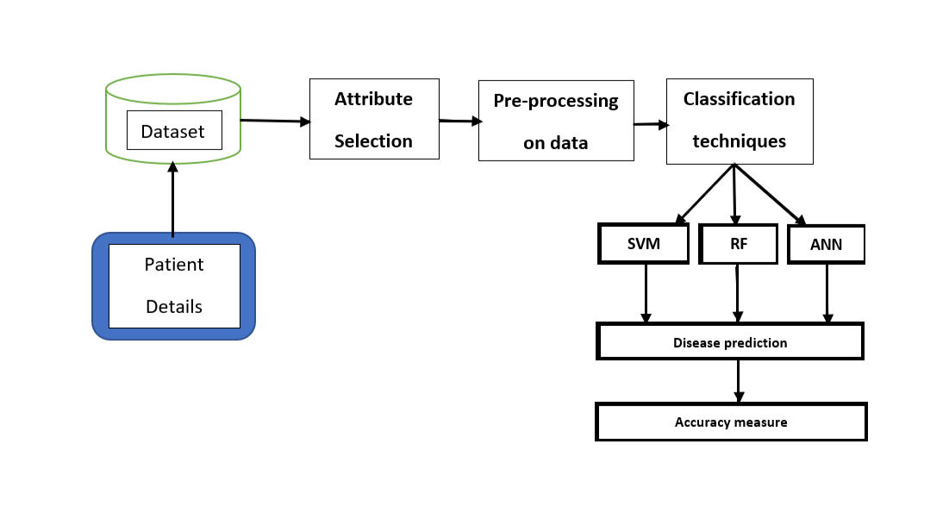
PROPOSED SYSTEM

Slide 8
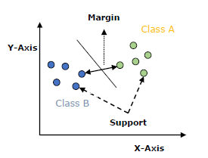
METHODOLOGY
Support Vector Machine(SVM)
Support Vector Machine or SVM is one of the most popular Supervised Learning algorithms, which is used for Classification as well as Regression problems. However, primarily, it is used for Classification problems in Machine Learning.
The goal of the SVM algorithm is to create the best line or decision boundary that can separate n-dimensional space into classes so that we can easily put the new data point in the correct category in the future. This best decision boundary is called a hyperplane.
SVM chooses the extreme points/vectors that help in creating the hyperplane. These extreme cases are called support vectors, and hence algorithm is termed as Support Vector Machine. Consider the below diagram in which there are two different categories that are classified using a decision boundary or hyperplane

Slide 9
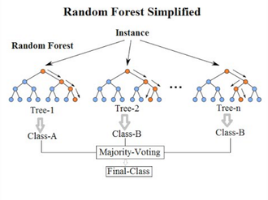
RANDOM FOREST
Random Forest is a classifier that contains a number of decision trees on various subsets of the given dataset and takes the average to improve the predictive accuracy of that dataset. Instead of relying on one decision tree, the random forest takes the prediction from each tree, and based on the majority votes of predictions, it predicts the final output. The greater number of trees in the forest leads to higher accuracy and prevents the problem of overfitting.

Slide 10
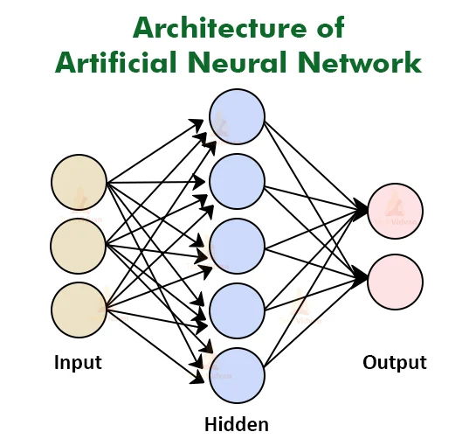
ARTIFICIAL NEURAL NETWORK(ANN)
These are used to model/simulate the distribution, functions, or mappings among variables as modules of a dynamic system associated with a learning rule or a learning algorithm. The modules here simulate neurons in the nervous system and hence ANN collectively refers to the neuron simulators and their synapse of these modules in different layers.
Neural Network is built by stacking together multiple neurons in layers to produce a final output. The first layer is the input layer and the last is the output layer. All the layers in between are called hidden layers. Each neuron has an activation function. Some of the popular Activation functions are Sigmoid, ReLU, tanh, etc. The parameters of the network are the weights and biases of each layer. The goal of the neural network is to learn the network parameters such that the predicted outcome is the same as the ground truth. Back-propagation along the loss function is used to learn the network parameters.

Slide 11
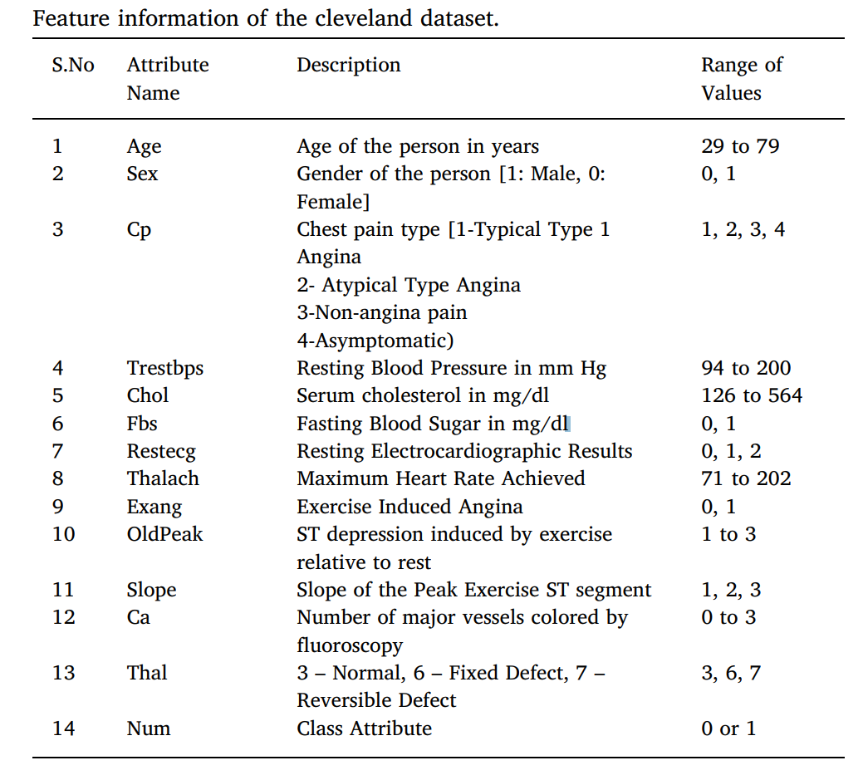
Cleveland dataset
The Cleveland heart dataset from the UCI Machine learning repository has been used for the experiments.
The dataset consists of 14 attributes and 1052 records.
There are 8 categorical attributes and 6 numeric attributes.
The description of the dataset is shown in the table.

Slide 12
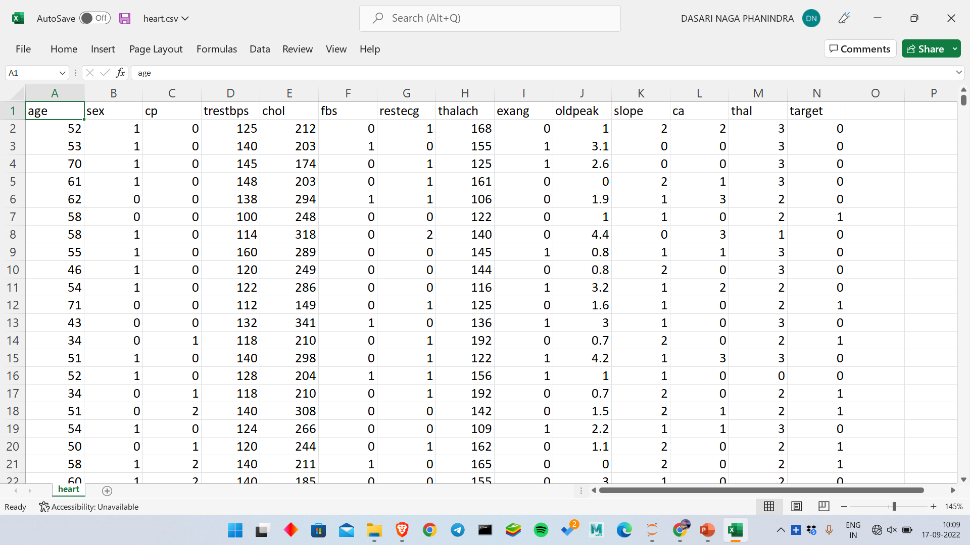

Slide 13
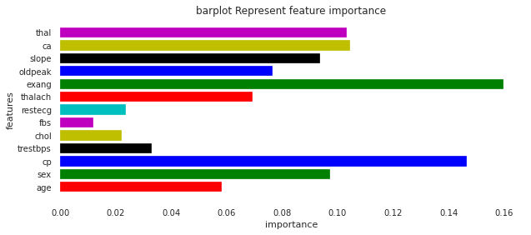
Feature Importance Graph

Slide 14
THANK YOU

